Slide 1

Automatic video summarization using ai
PROJECT TITLE
Batch Number : A5
by,
1. USN:3VC23CS015 NAME:BANAKARA NIVEDITHA
2. USN:3VC23CS025 NAME:CHANDANA U K
3. USN:3VC23CS019 NAME:BHAGYASHREE
4. USN:3VC23CS041 NAME:GAUTHAMI B R
Under the Guidance of,
RAJESHWARI
Assistant Professor
Department of CSE,
RYMEC

Slide 2

Table of Content
Objectives
Literature Survey
Methodology
System architecture
Implementation
Results
Conclusion

Slide 3
Objectives
Automate Video Processing
Accept video input and run the full pipeline automatically.
Convert Speech to Text
Extract audio and transcribe it accurately using faster-whisper.
Generate AI Summaries
Produce concise summaries using local Ollama + Llama 3.2.
Deliver via Web Interface
Upload videos, track progress, view and download summaries easily..

Slide 4
Literature Survey
Year/ Author Name | Title of the work | Methodology Used | Accomplished work | Limitation / Future work
2003 / Hong-Jiang Zhang et al. | Automatic Video Summarization by Graph Modeling | Graph-based modeling | Extracted keyframes by,analyzing relationships b/w video frames | No deep learning, poor semantic understanding
2008/ Arnaldo De et al. | VSUMM: Automatic Video Summarization , Evaluation | Feature extraction + clustering | Generated static Summaries& evaluates method | Limited to visual features, no audio/text analysis
2023 / Jia-Hong Huang et al. | Causalainer: Causal Explainer for Video Summarization | Clustering + semantic content mining | Improved grouping of similar scenes and semantic summarization | Depends on handcrafted features, less accuracy
2023 / Sharma et al. | Video Summarization using Affinity Propagation Clustering | Transformers (self-attention models) | Better context understanding and sequence modeling | Requires large datasets

Slide 5
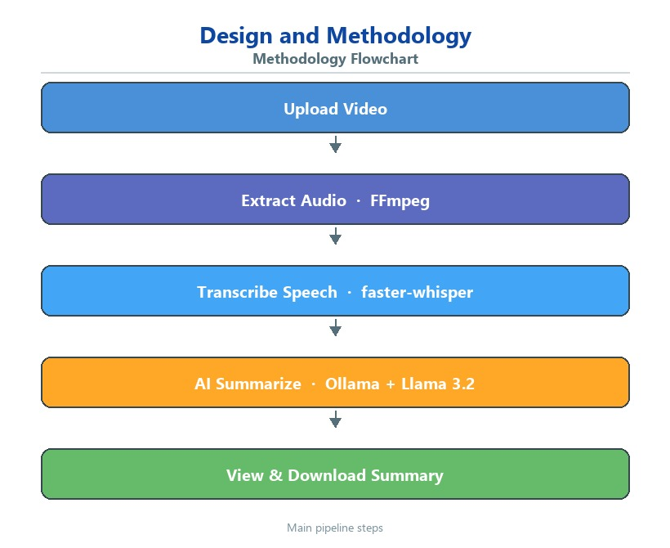
Methodology Used

Slide 6
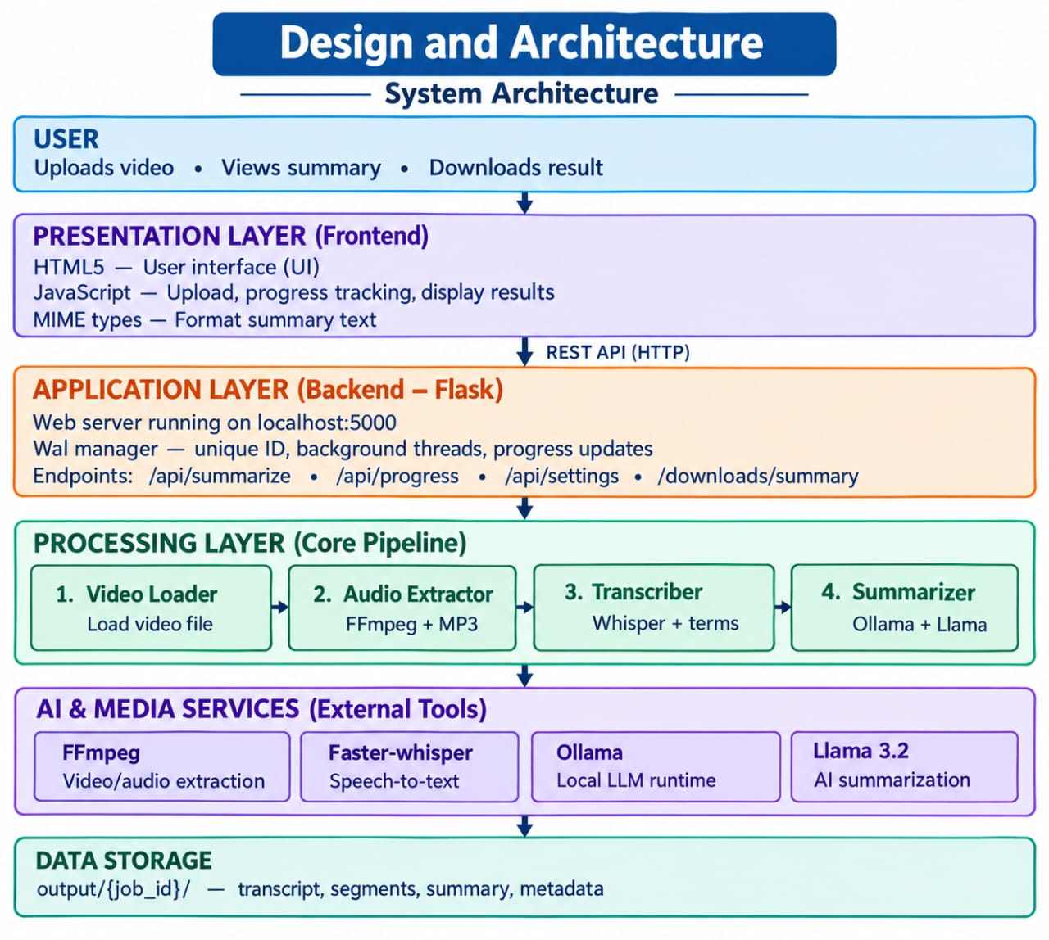
System architecture

Slide 7
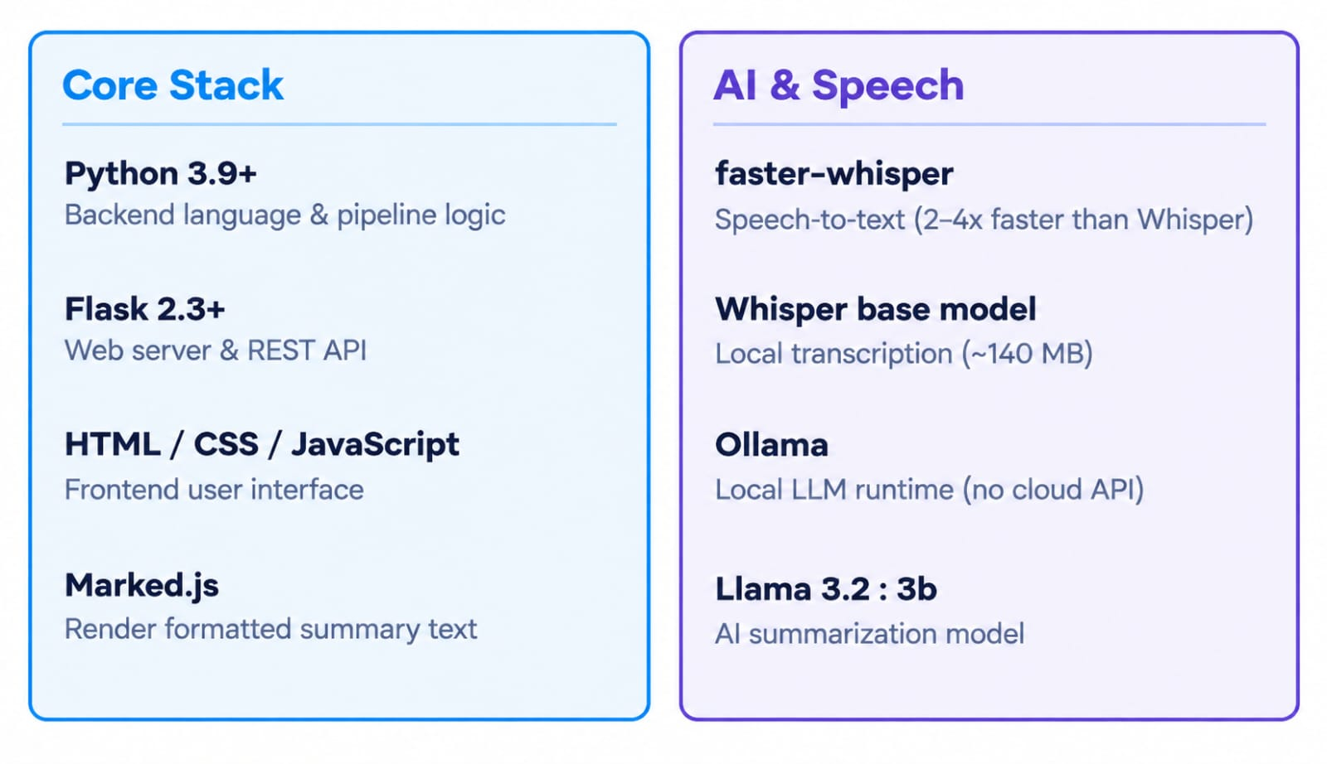
Implementation

Slide 8
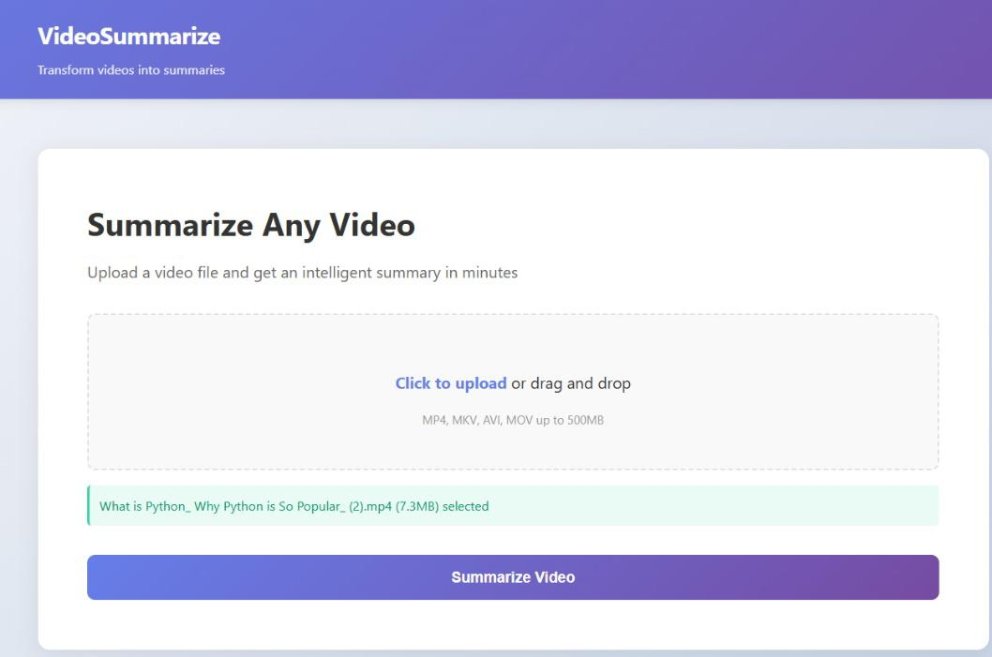
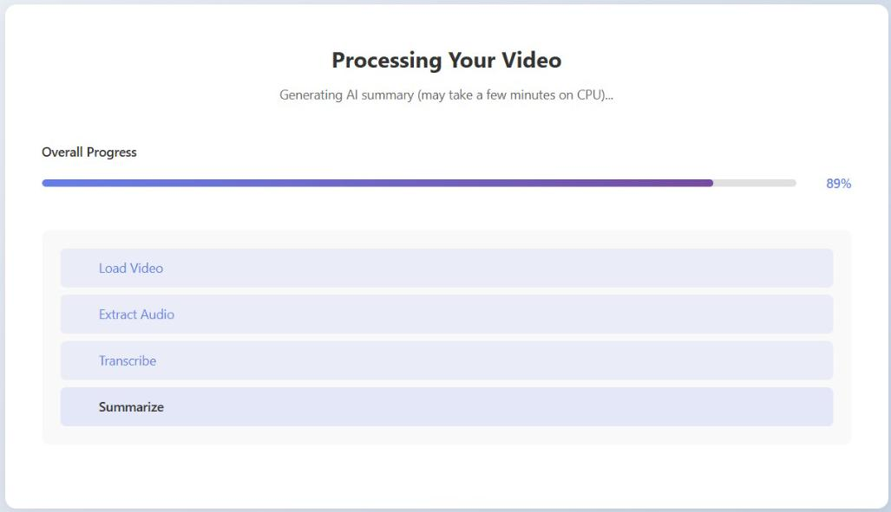
Result

Slide 9
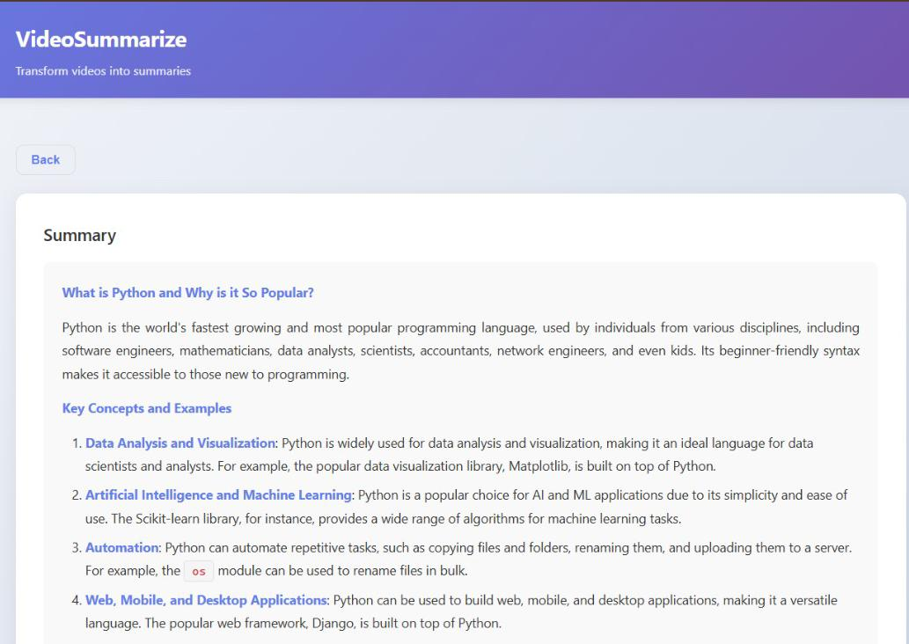
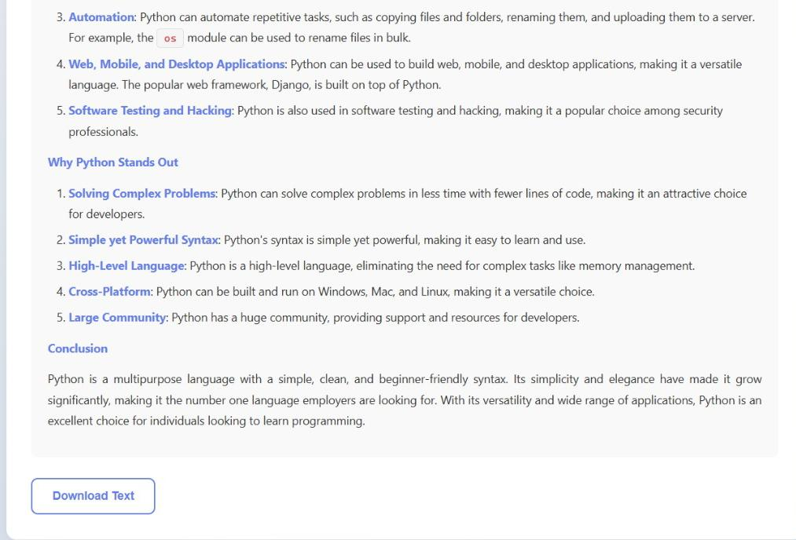

Slide 10
conclusion
Built an AI-based system for automatic video summarization.
Converts long videos into short and meaningful summaries.
Combines video frames, audio, and text for better understanding.
Uses AI and NLP techniques to identify important content.
Generates summarized text and important video segments.
Reduces the time required to watch long videos.

Slide 11
Next Step
User-Friendly UI – Develop an easy-to-use interface for video upload and summary.
TTS Audio Summary – Add voice output for the generated summary.
SRT Subtitles – Generate subtitles automatically from the summary.
Job History – Store and view previously processed videos and summaries.
GPU Acceleration – Use GPU processing for faster video summarization.
Multi-Language Support – Support summaries in multiple languages.
Mobile-Friendly UI – Make the system accessible on mobile devices.

